Slide 1

Effect of Covid-19 on Birth in California Counties
Data Visualization – Group 7
Bindu Musham
Raeiy Woldemariam
Karthik Devuluri
Narendranath Chowdary Pendyala
Shanephear John Cleetus

Slide 2
Agenda
Hypothesis 1: Whether mothers in age group of 24-34 gave more births as compared to mothers of age group 35-44 in California Counties.
Hypothesis 2: Did mothers with higher degrees (bachelor’s degree and above) have less births than mothers with Associate degrees and lower in California Counties.
Hypothesis 3: Whether the birth rate among white mothers decreased the most when compared with the other ethnicities in California during the pandemic.
Hypothesis 4: Whether the birth rate in California counties had an overall decrease in 2020 when compared to 2019 due to Covid.
Hypothesis 5: Whether San Francisco is more likely to have higher birth rate because of its higher population density.

Slide 3
Introduction
In this project, we wanted to investigate if the COVID-19 pandemic had any effects on the birth rate of California by analyzing pre-pandemic and pandemic data. We are considering various factors like mother’s age, race and education level to see if these factors effected the birth rates during Covid. Overall, to see if there is a “baby bust” during Covid.
Our dataset is taken from Wonder database and consists of 17945 records.

Slide 4
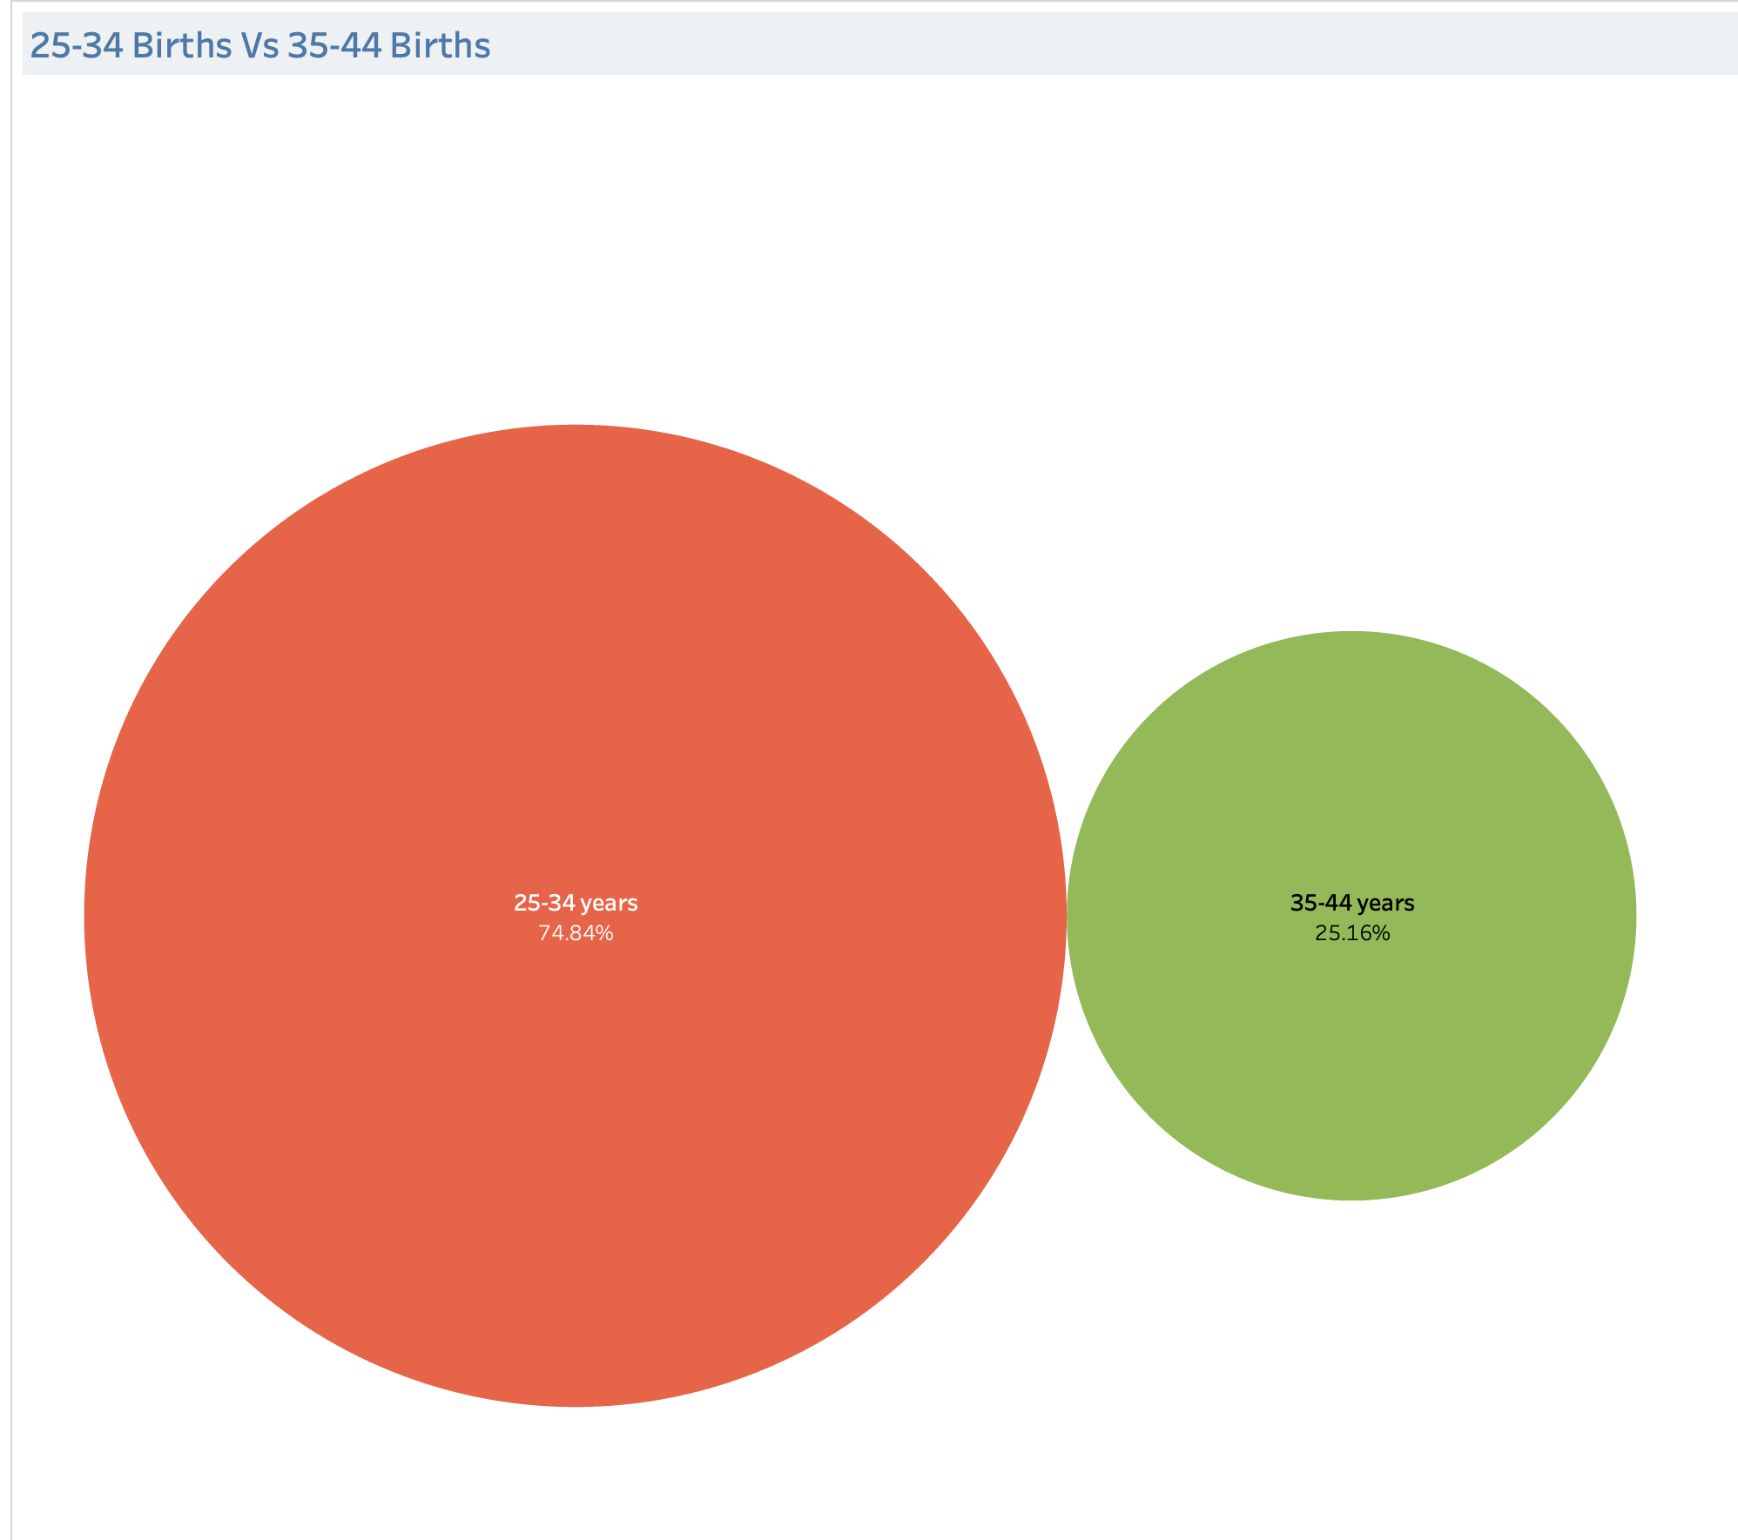
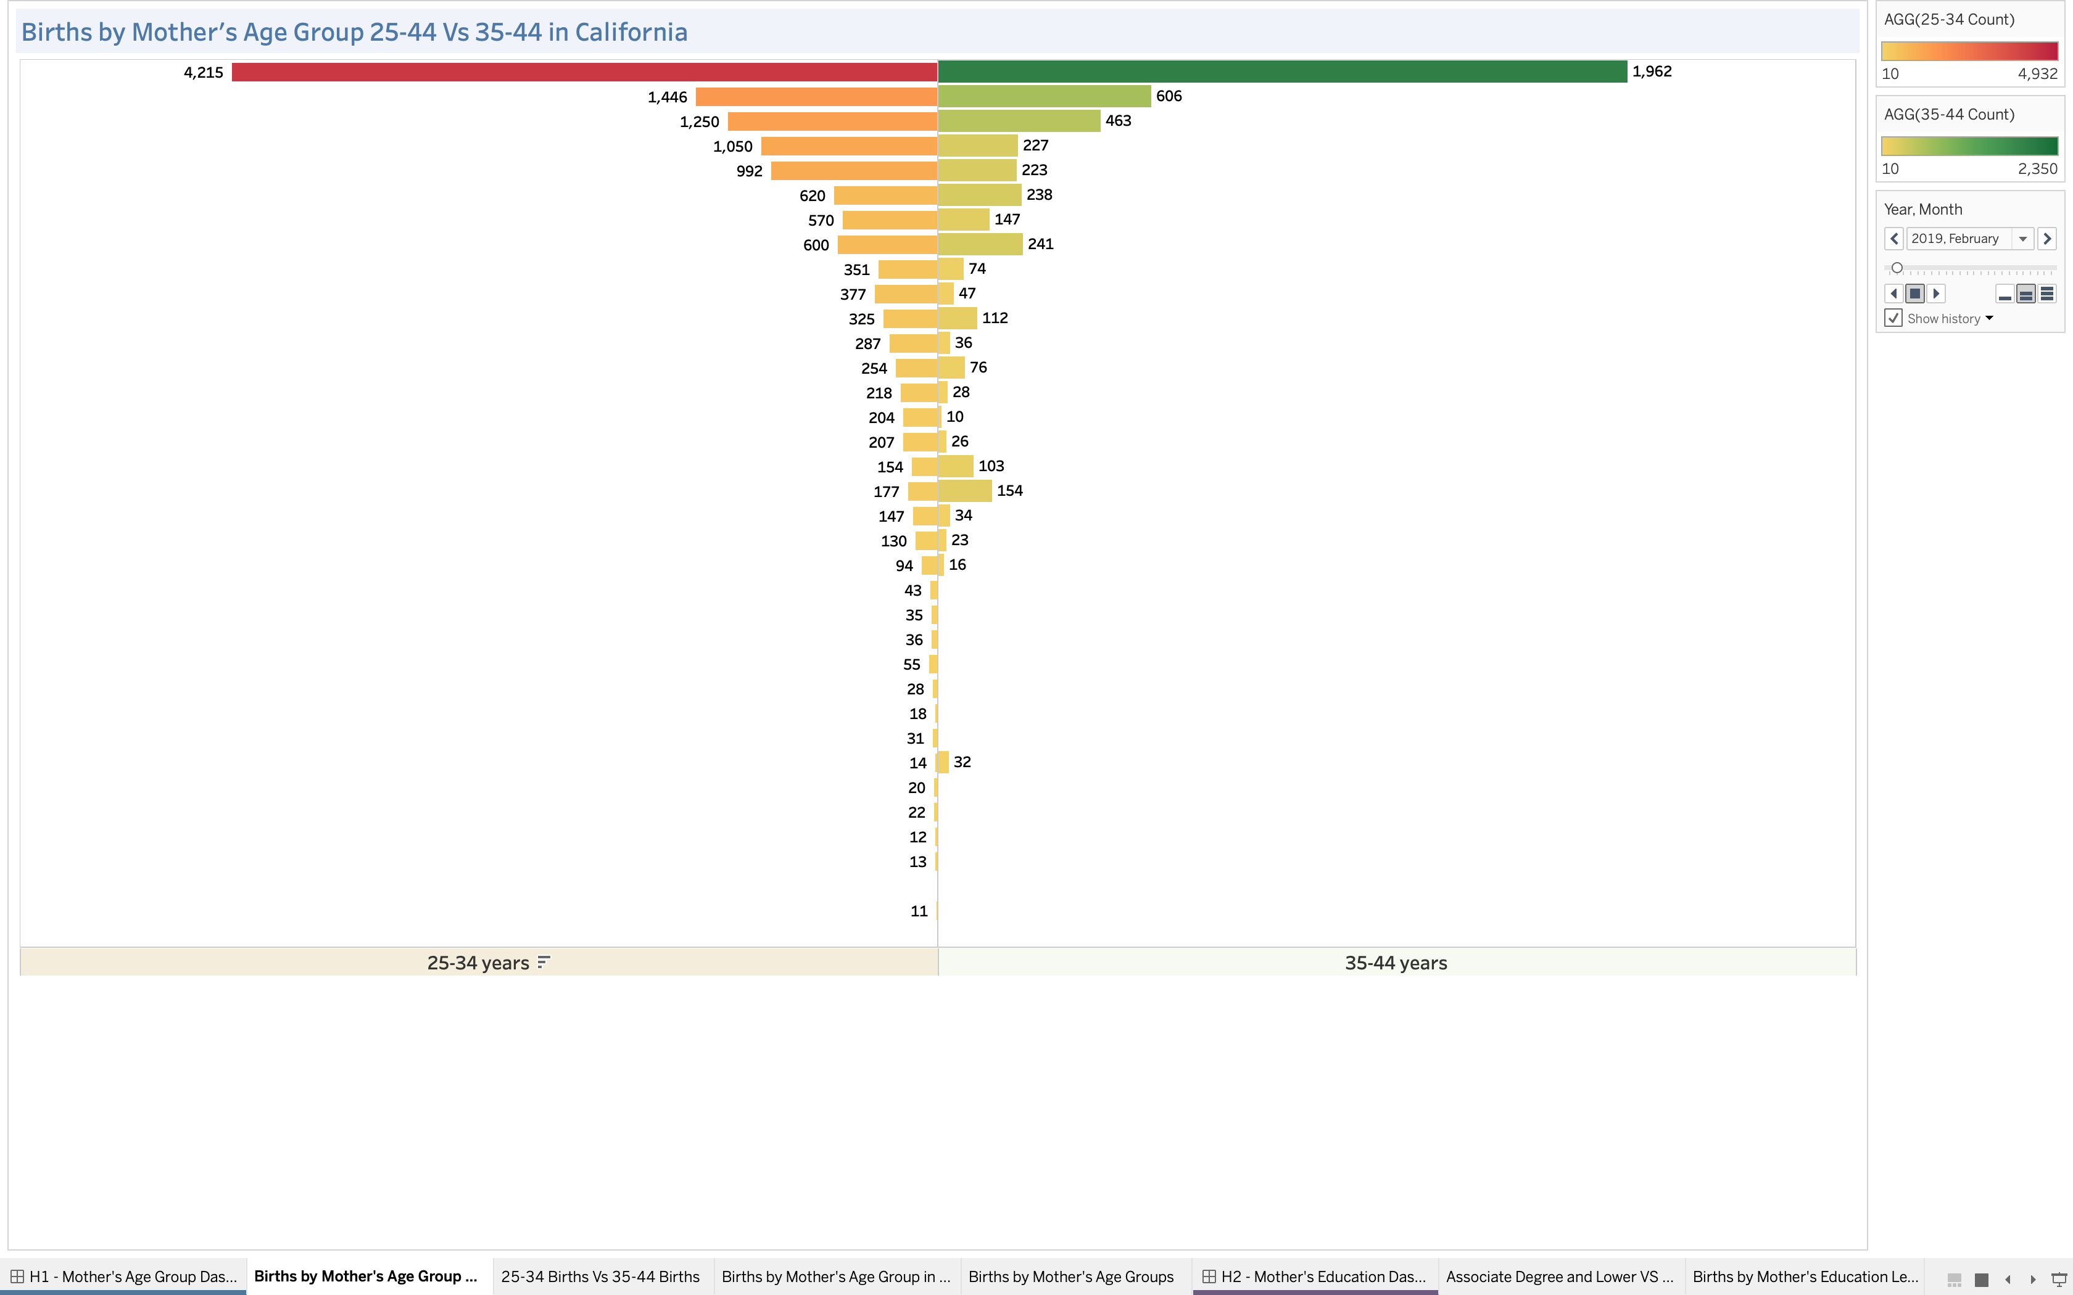
Hypothesis 1 – Mother’s Age Group on Birth
In any period of time the number of births in 25-34 is around 5000 while 35-44 is 2500 which we can see in second chart of dashboard.
From the bubble chart, it is clearly visible that mothers in the age group 25-34 gave 50% more births compared to mothers in the age group 35-44.

Slide 5
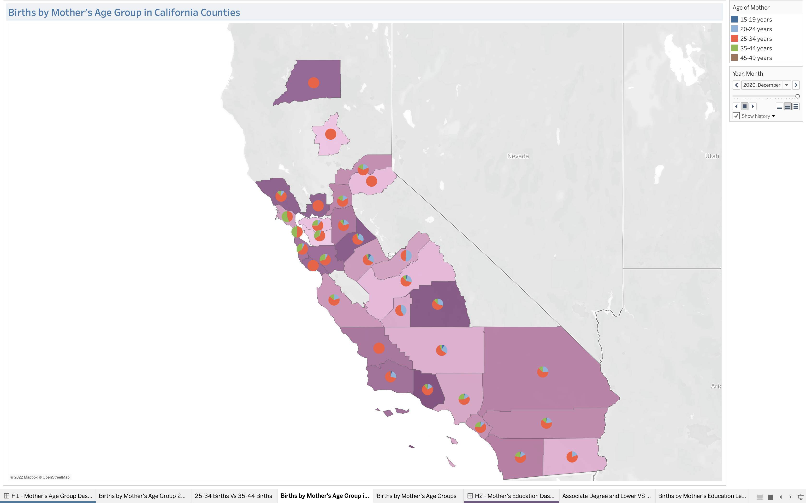
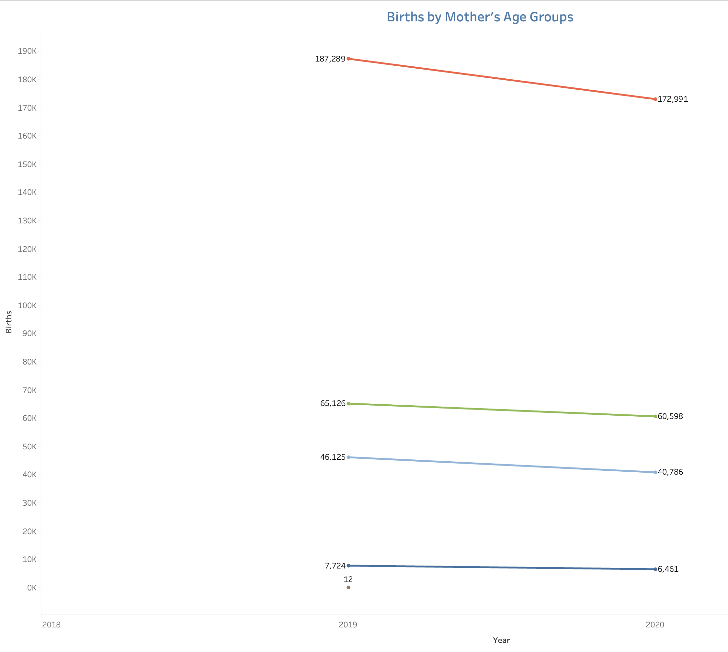
We can see that the number of births across age groups is constant for 2019 and 2020, but overall, the decrease in births in the age group 25-34(~14000) is more compared to the decrease in the births of 35-44(~4500). This implies that the mothers of 25-34 ages had more fear of covid compared to 35-44 which resulted in more decline of births.
The proportion of age groups and births by county is shown using filled maps with pie charts.
Thus, our hypothesis is proven to be false and rejected.

Slide 6
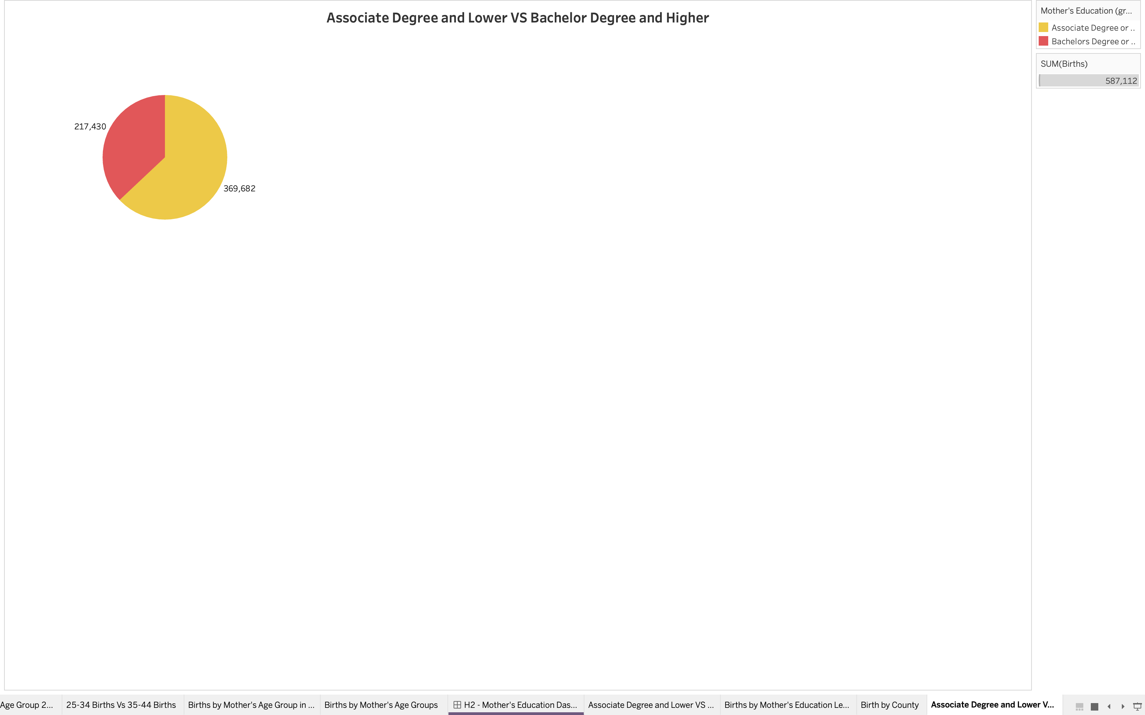
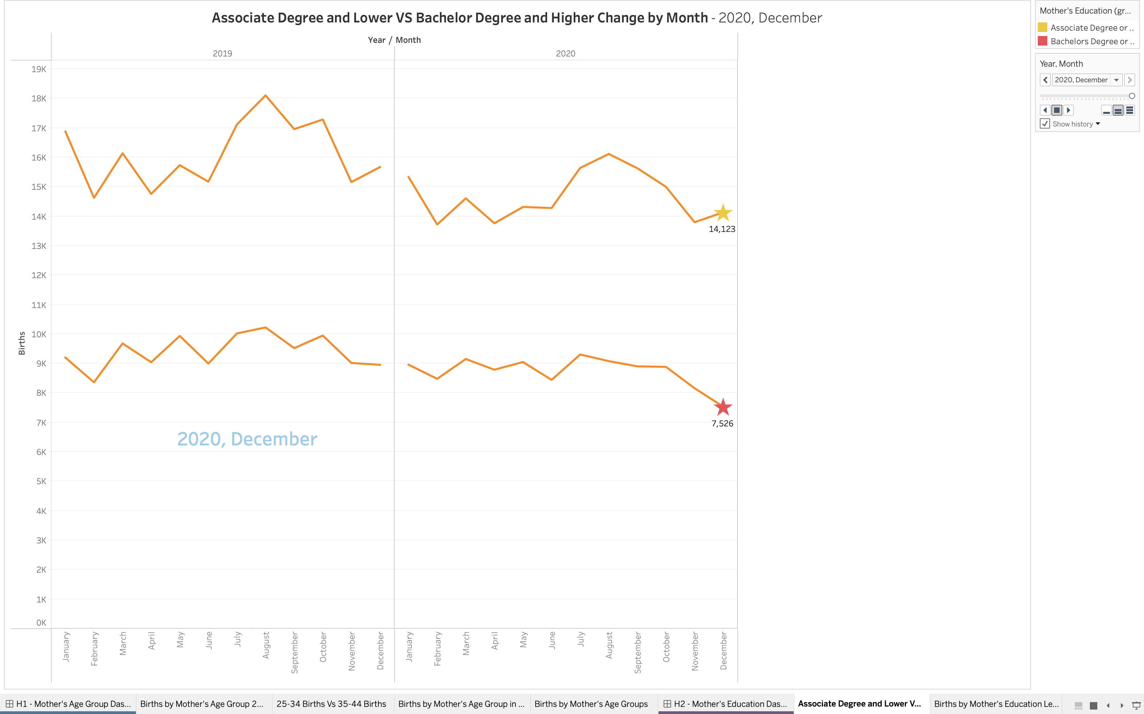
Hypothesis 2 – Mother’s Education on Birth
As we can see from the pie chart, both 2019 and 2020 during the pandemic, Mothers with at least an Associate degree were having more babies than mothers with a bachelor’s degree or higher.
In 2019 women with a bachelor’s degree and above were having 15K births per month on average and in 2020 we can see the decrease of the babies being born throughout the months.

Slide 7
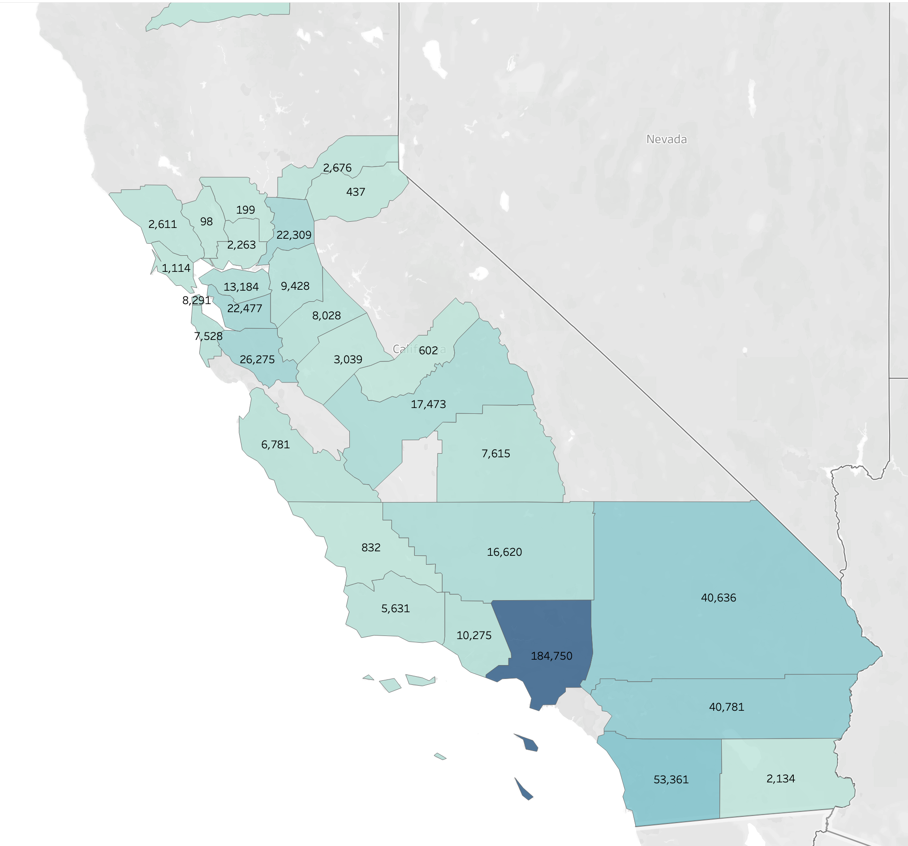
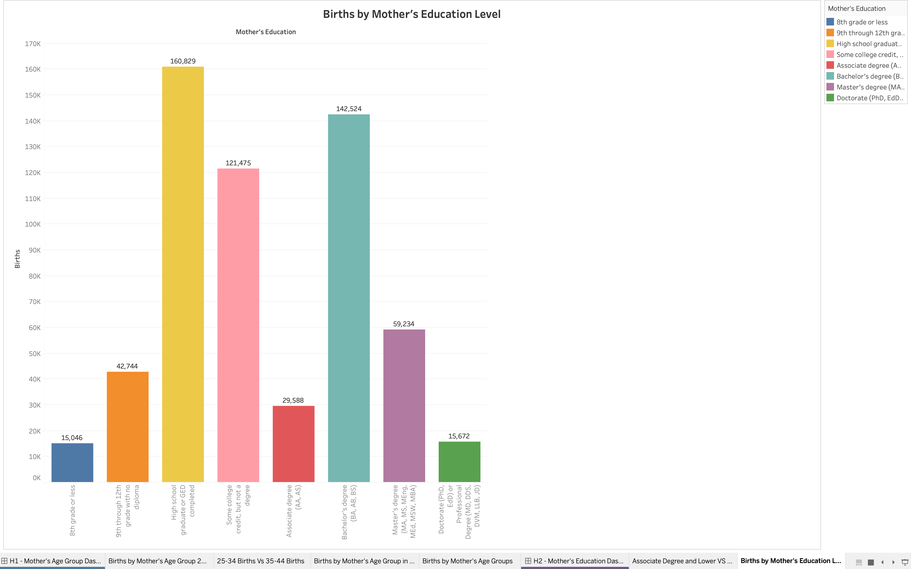
Los Angeles county is the most populated county in California, and it accounts for the highest amount of birth for both the education categories.
San Francisco County is most densely populated county which almost all of the total births are by women who have at least a bachelor’s degree or higher and from that mothers with a Bachelor’s Degree are the largest amount.
And from the visualization on the left, we can see that mothers with at least a High School Diploma or GED had the greatest number of babies at ~160,000.
And the most and least educated women, were having the least number of babies.
Thus, our hypothesis is proven to be true and accepted.

Slide 8
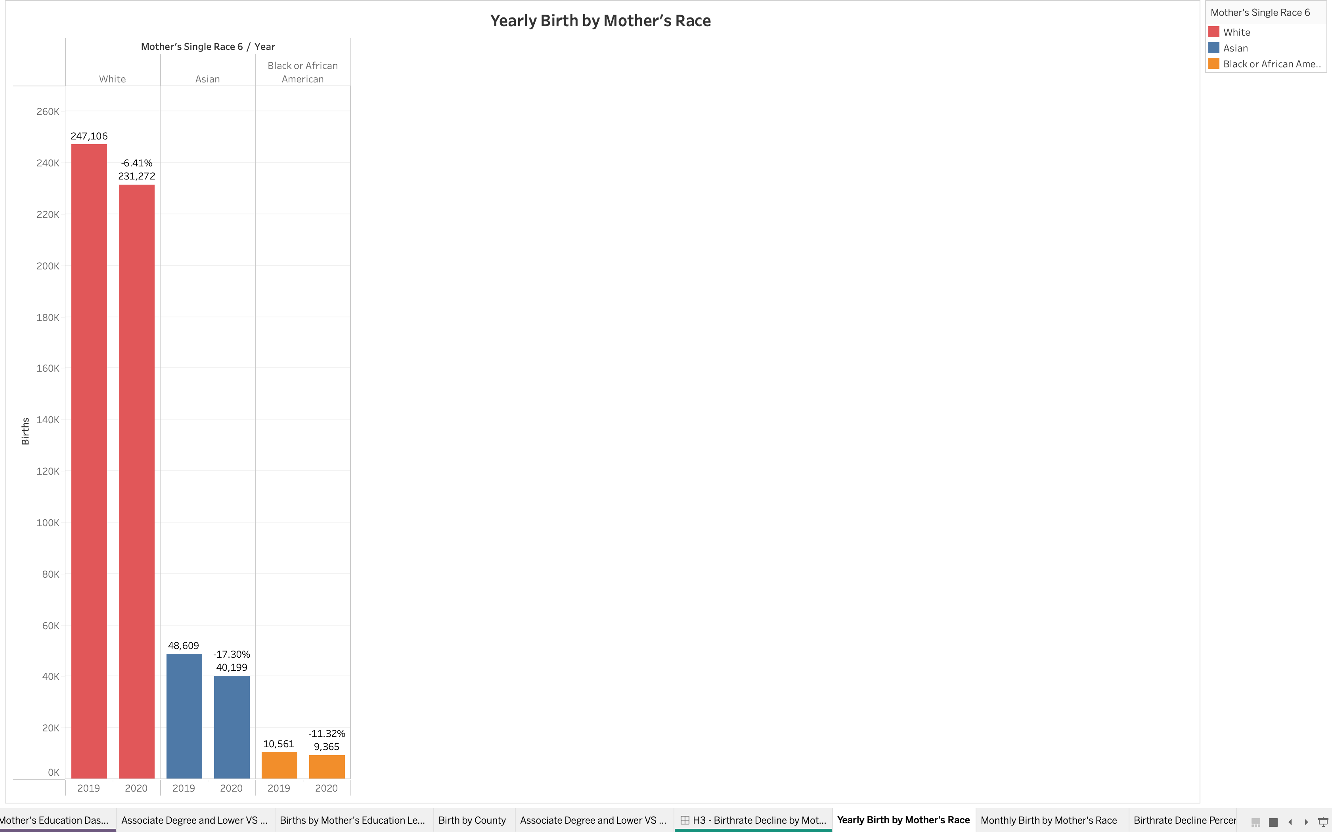
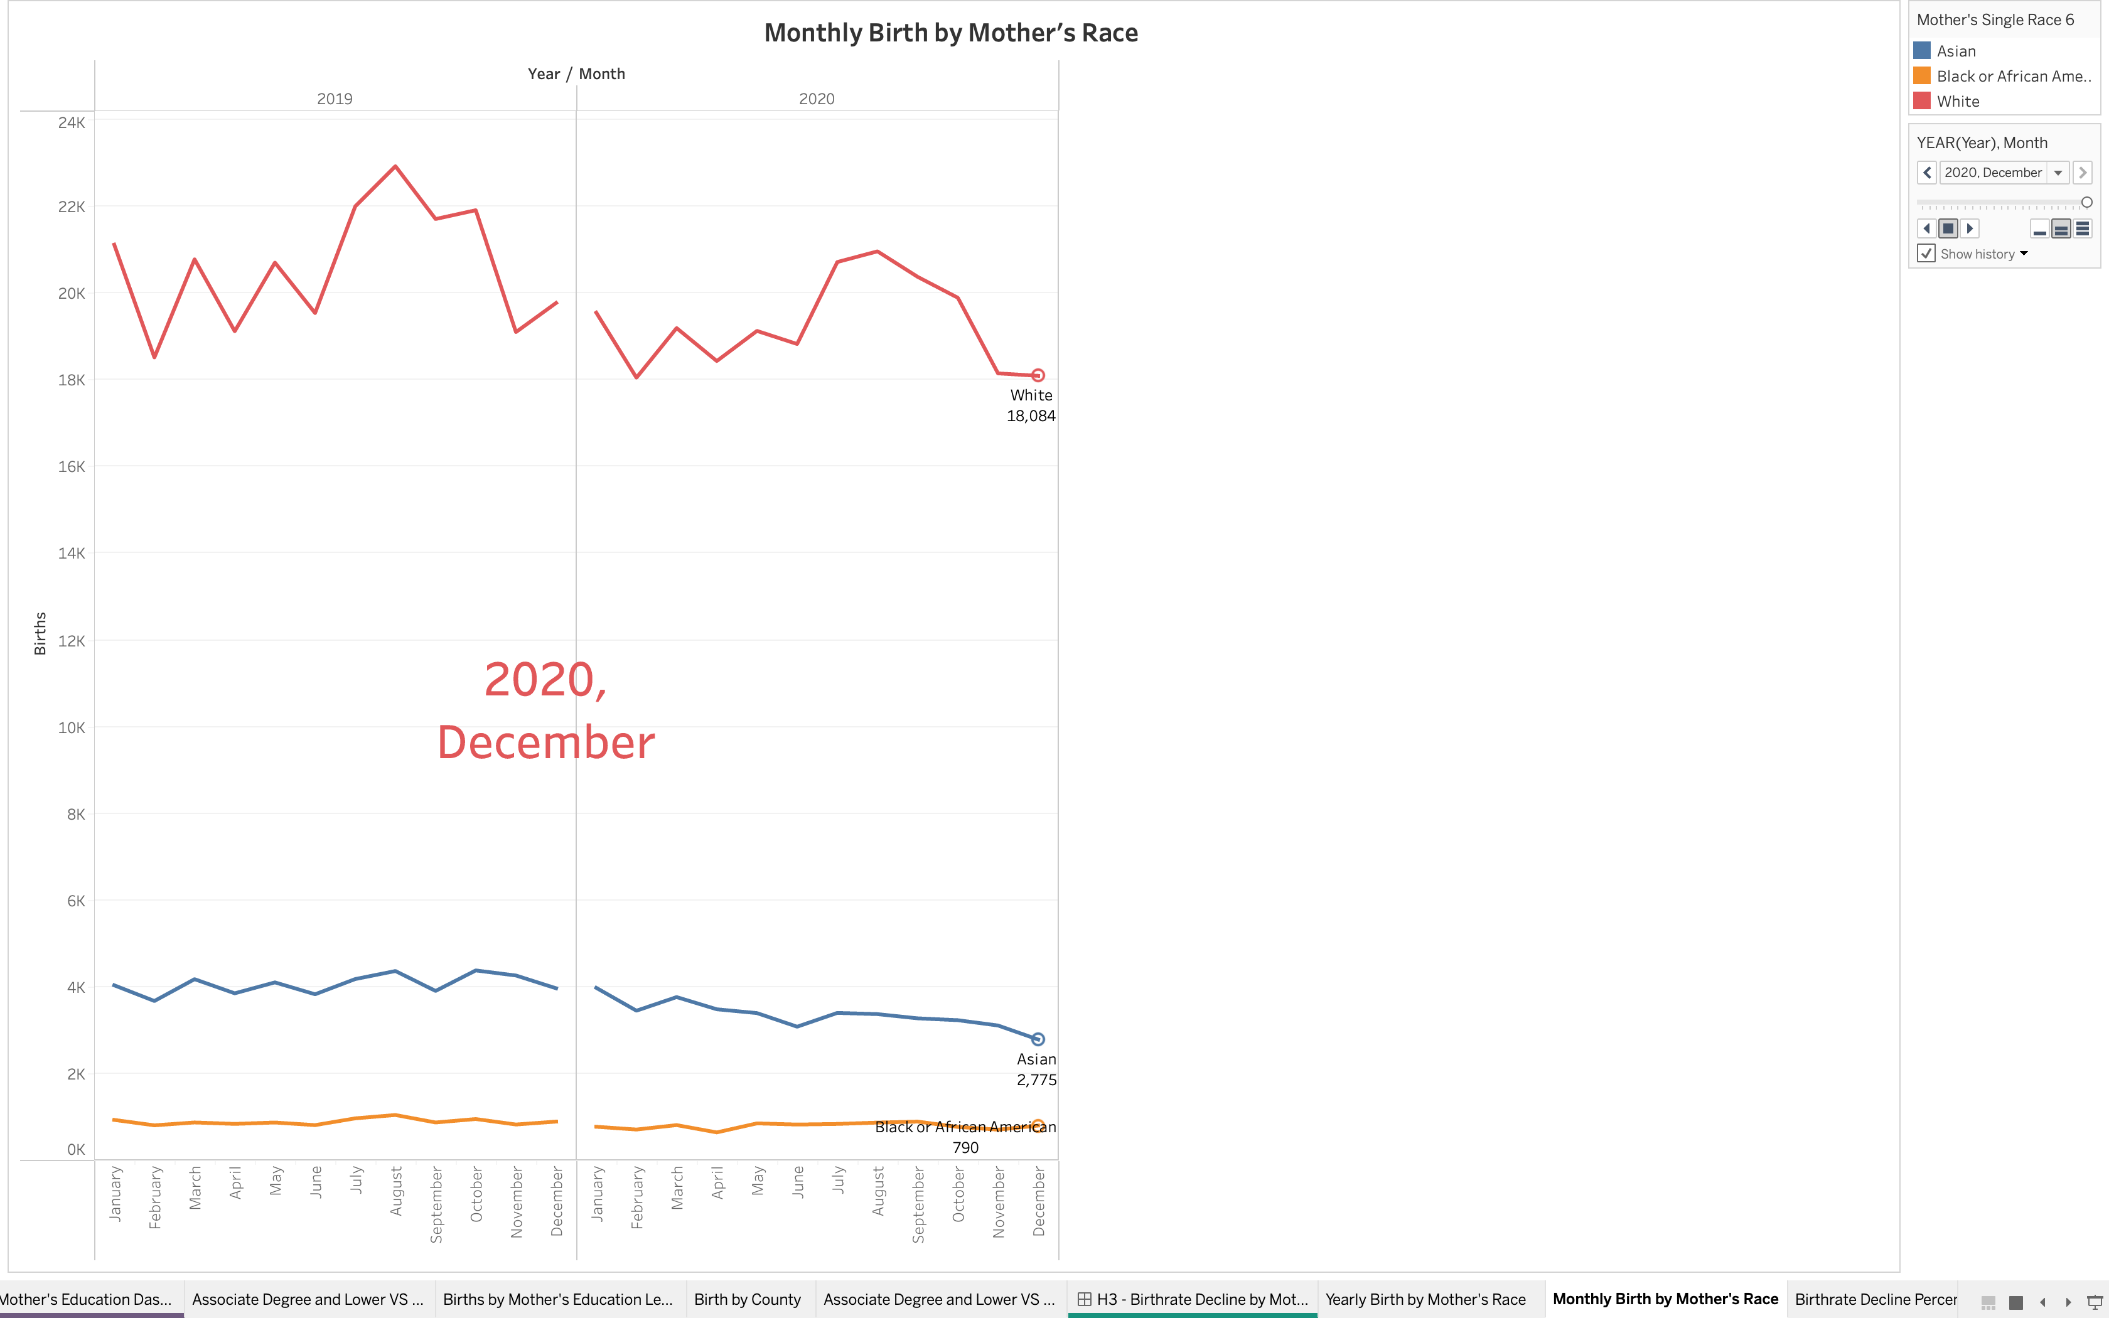
Hypothesis 3 – Mother’s Race on Birth
The third hypothesis is to see whether white women were more reluctant to become mothers during the covid time when compared with Asian or Black/African American ethnicities.
These values indicate that white mothers showed a very less decline in birth rates when compared to the other two ethnicities proving the hypothesis wrong.

Slide 9
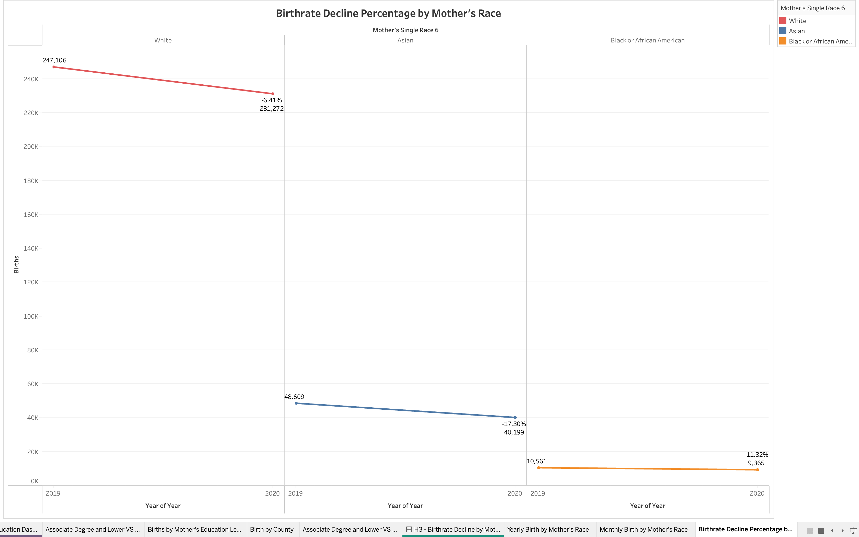
The trend lines show that all the ethnic group mothers show a decline in the birth rate. The birth rate decline in Asian mothers is -17.30%, whereas the decline rate is -11.32% among Black/ African American women and white mothers showed a downtrend of -6.41%.
Thus, our hypothesis is proven to false and rejected.

Slide 10
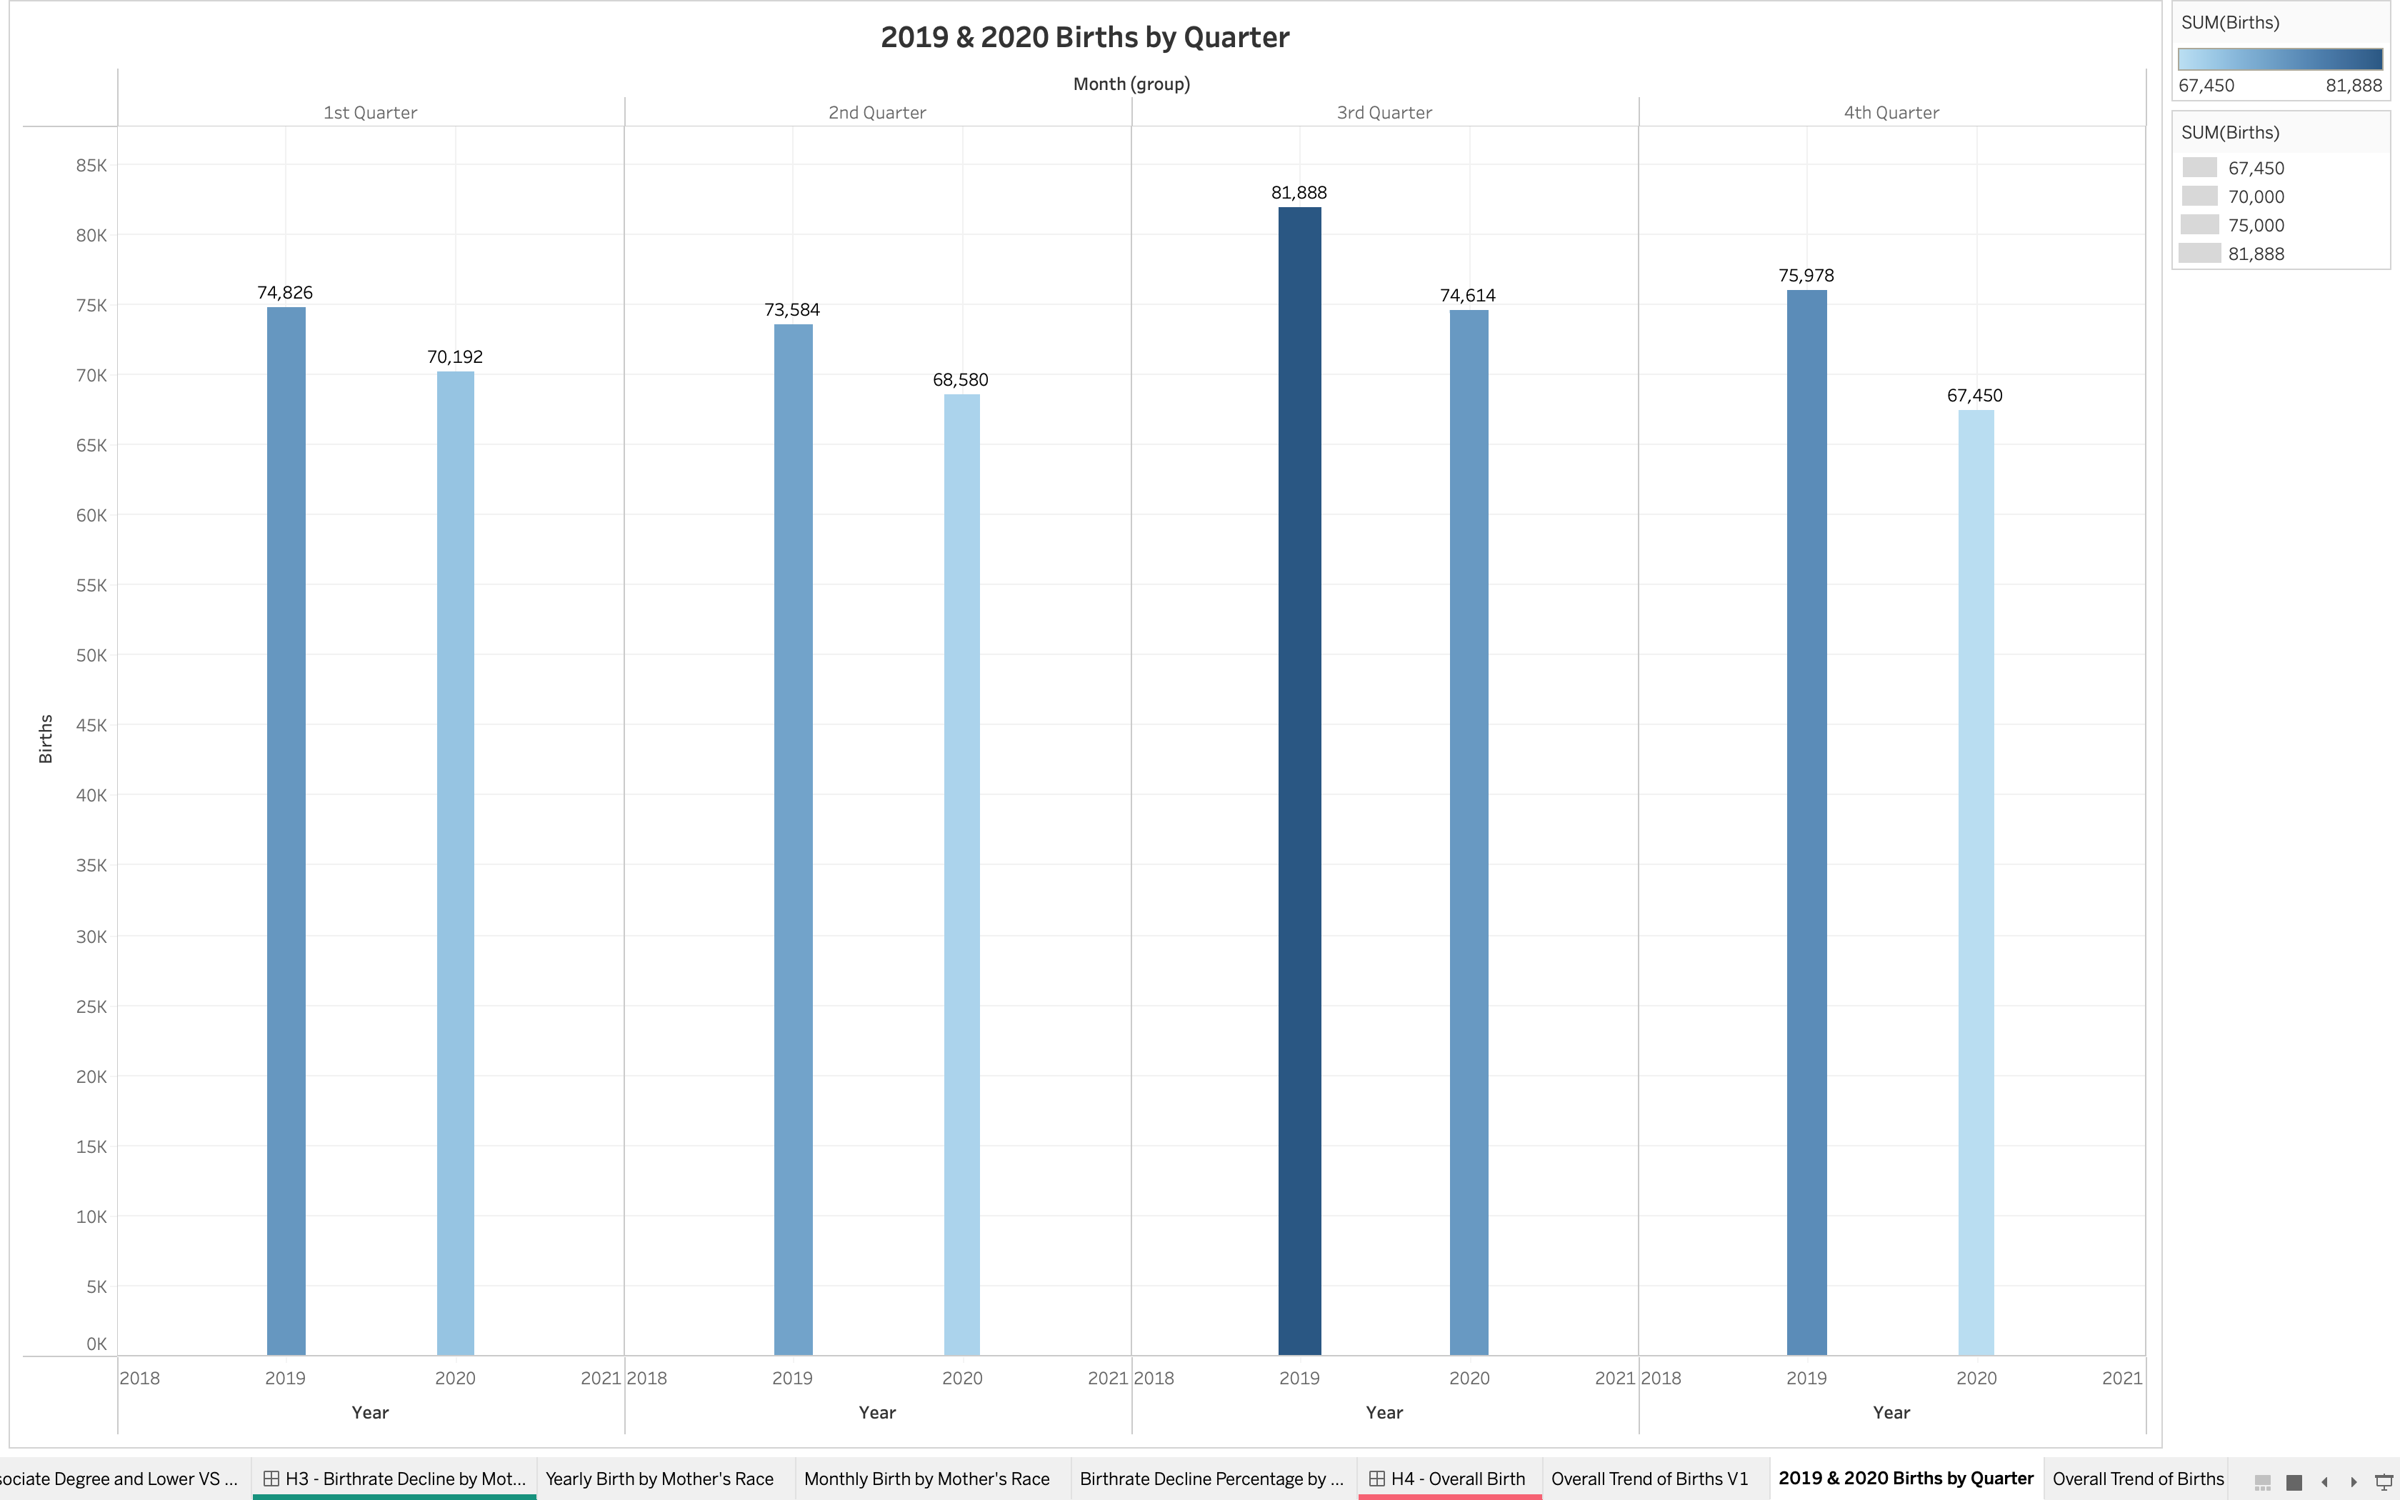
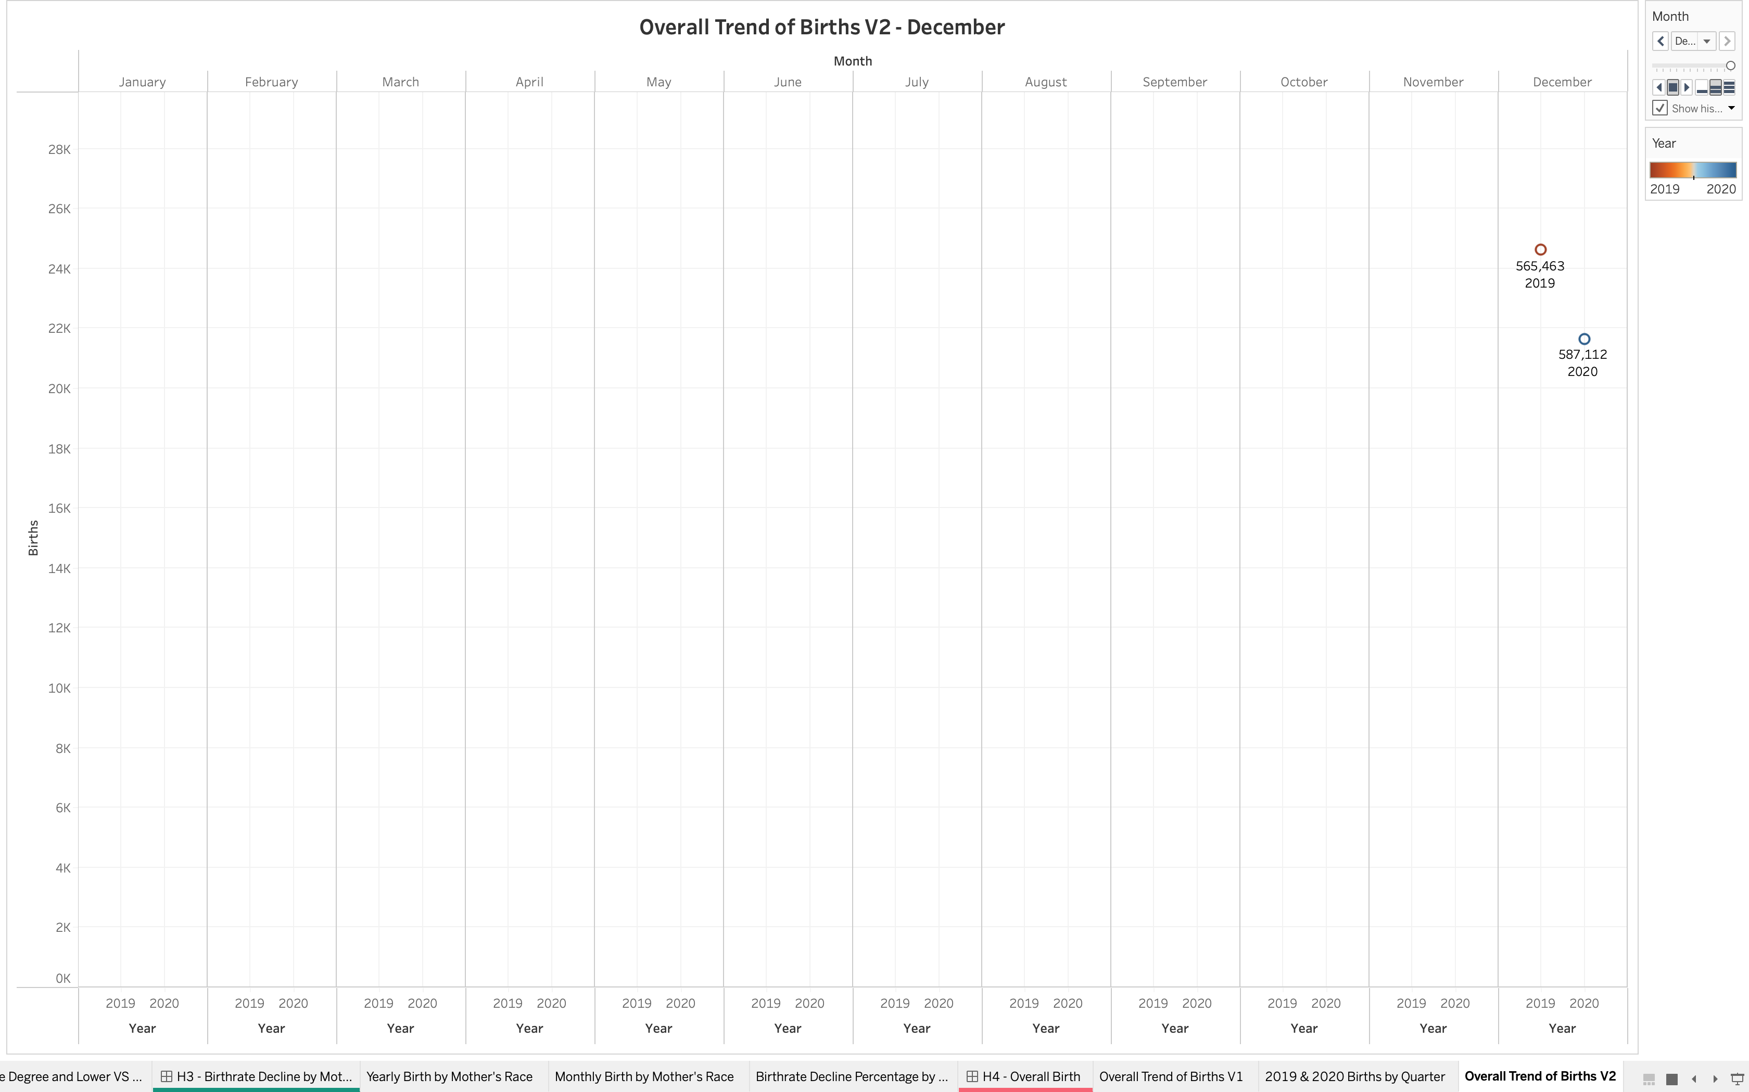
Hypothesis 4 – Overall Birth Decrease
In a few counties the birth rate was more in 2020 than in 2019.
When we look at quarters for the two years, all of 2020’s four quarters were recorded to be lower than 2019.

Slide 11
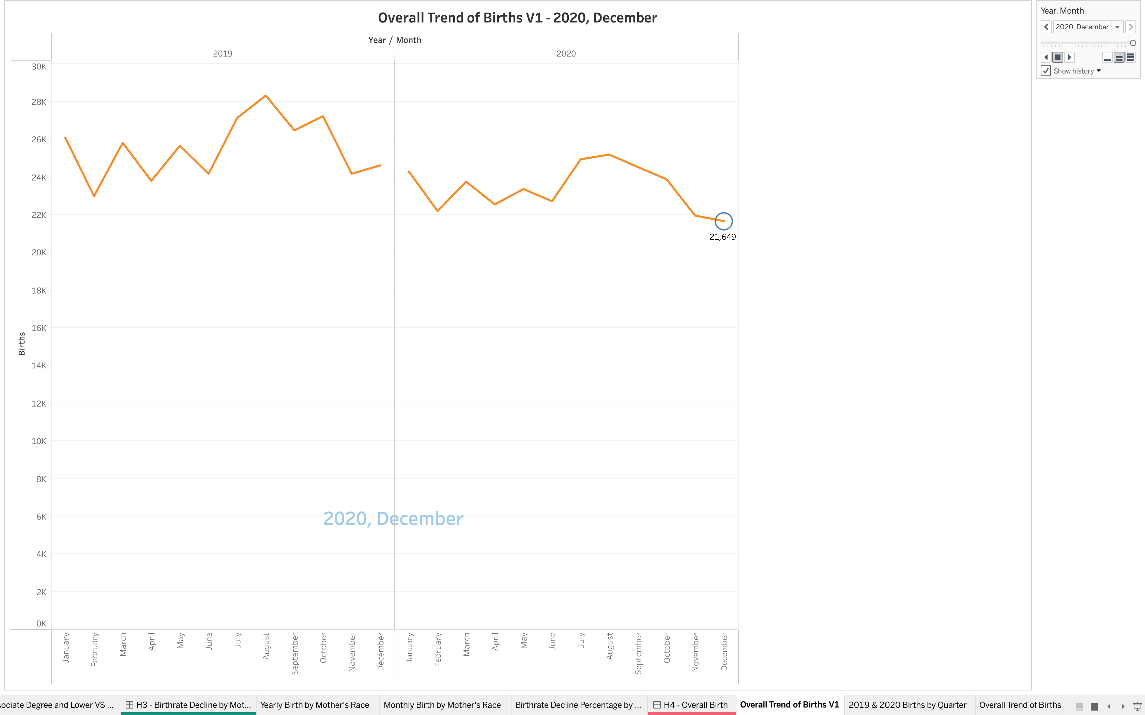
This could have happened due to the different type of measures and their implementation to prevent covid 19 in various counties and how strictly they followed that and the number of cases in that county which made the people to take their decisions.
But in overall comparison the birthrate in California did decrease in 2020 than compared to what it was in 2019.
Thus, our hypothesis is proven to be true and accepted.

Slide 12
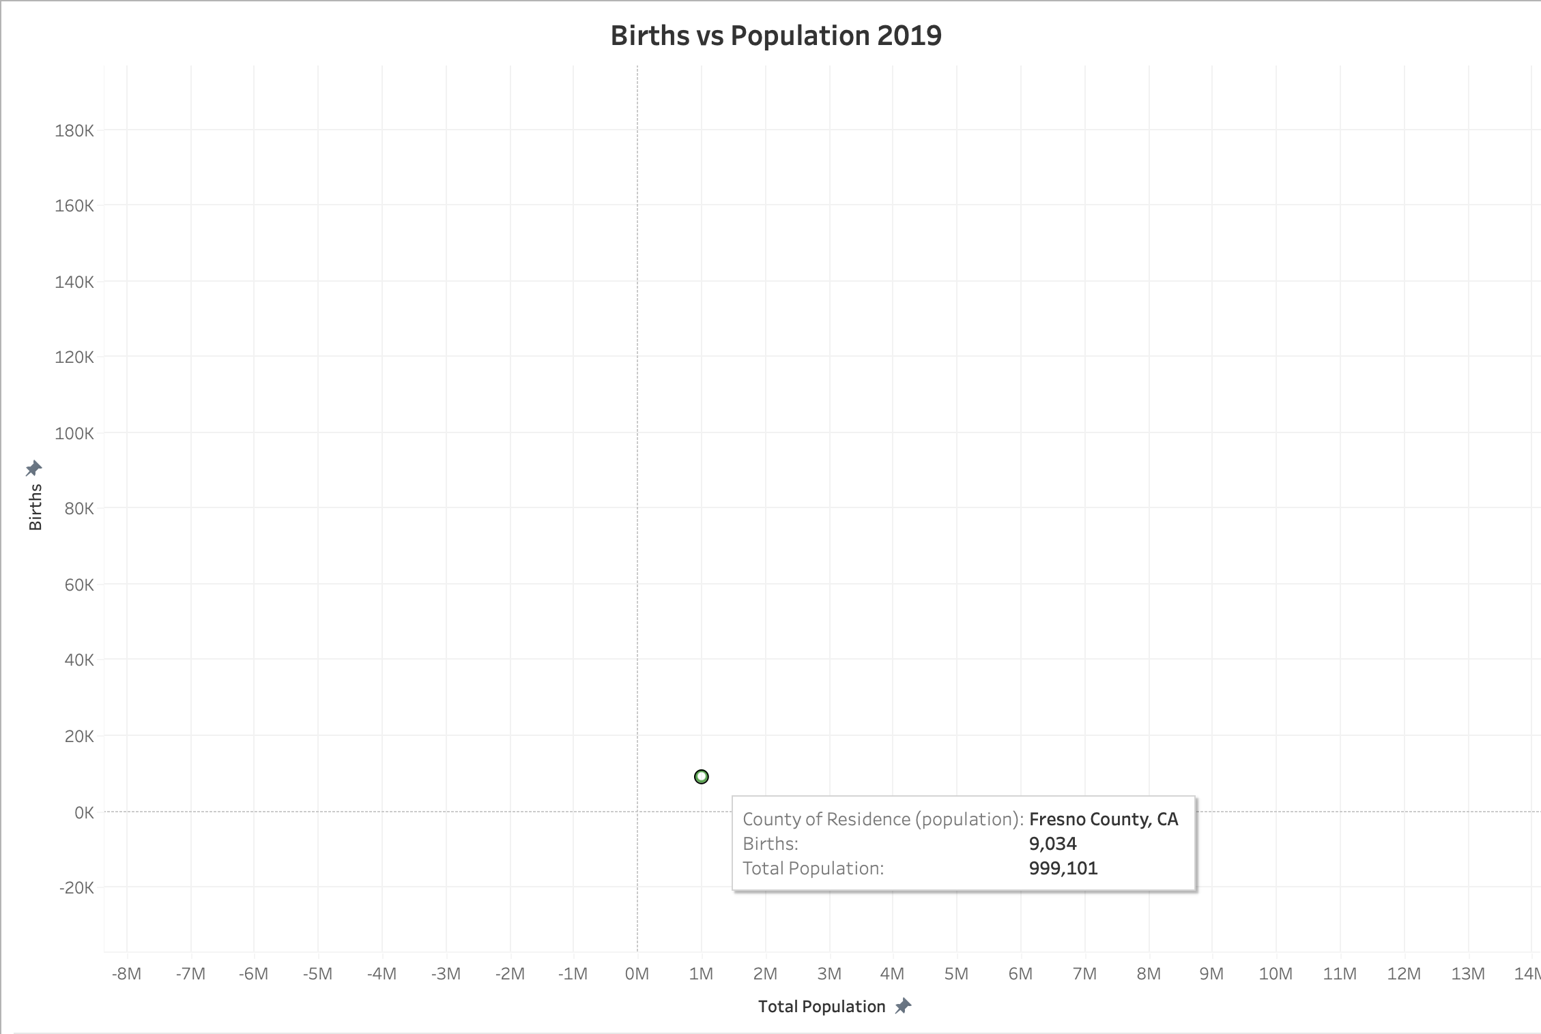
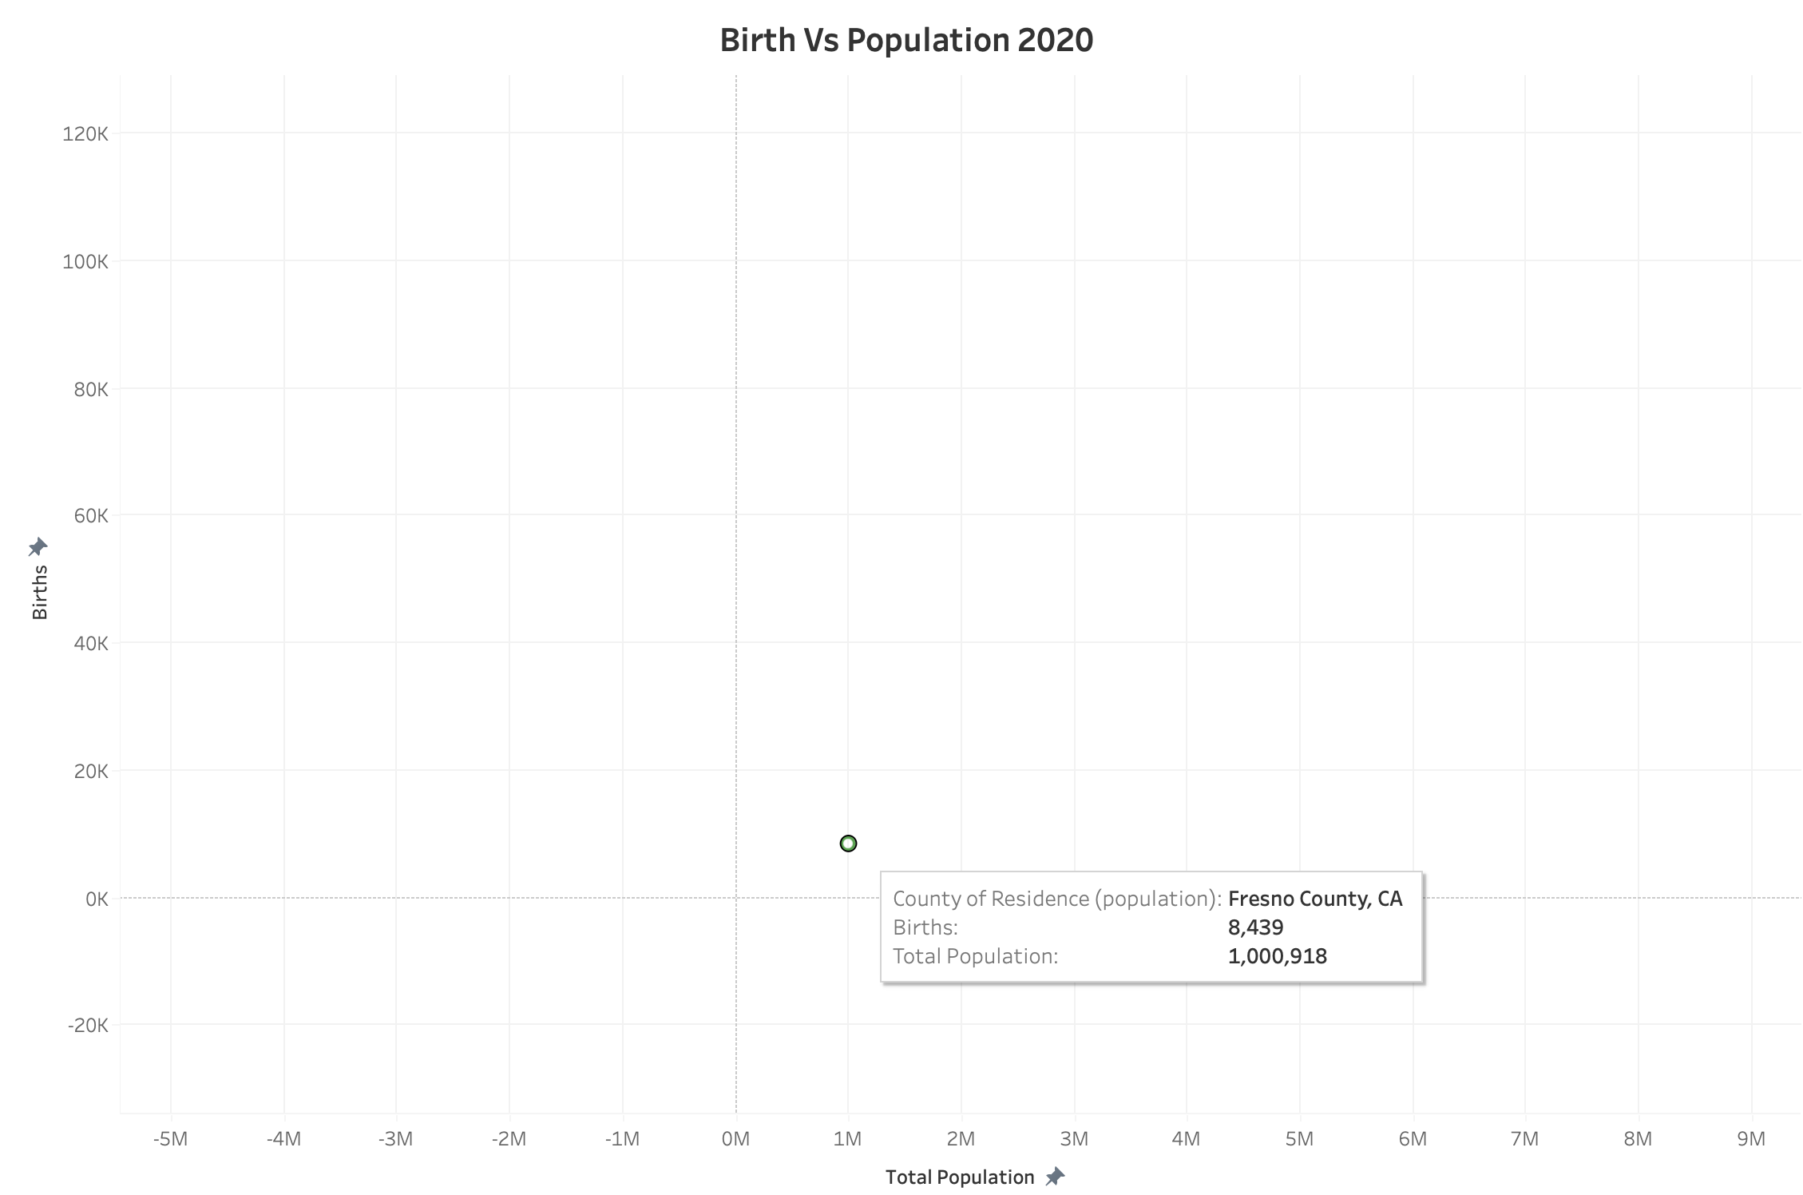
Hypothesis 5 – San Francisco County and Birth
The births and population are directly proportional to each other according to scatter plot pattern.
Fresno County Population in 2019 - 999,101
Fresno County Population in 2020 – 1,000,918

Slide 13
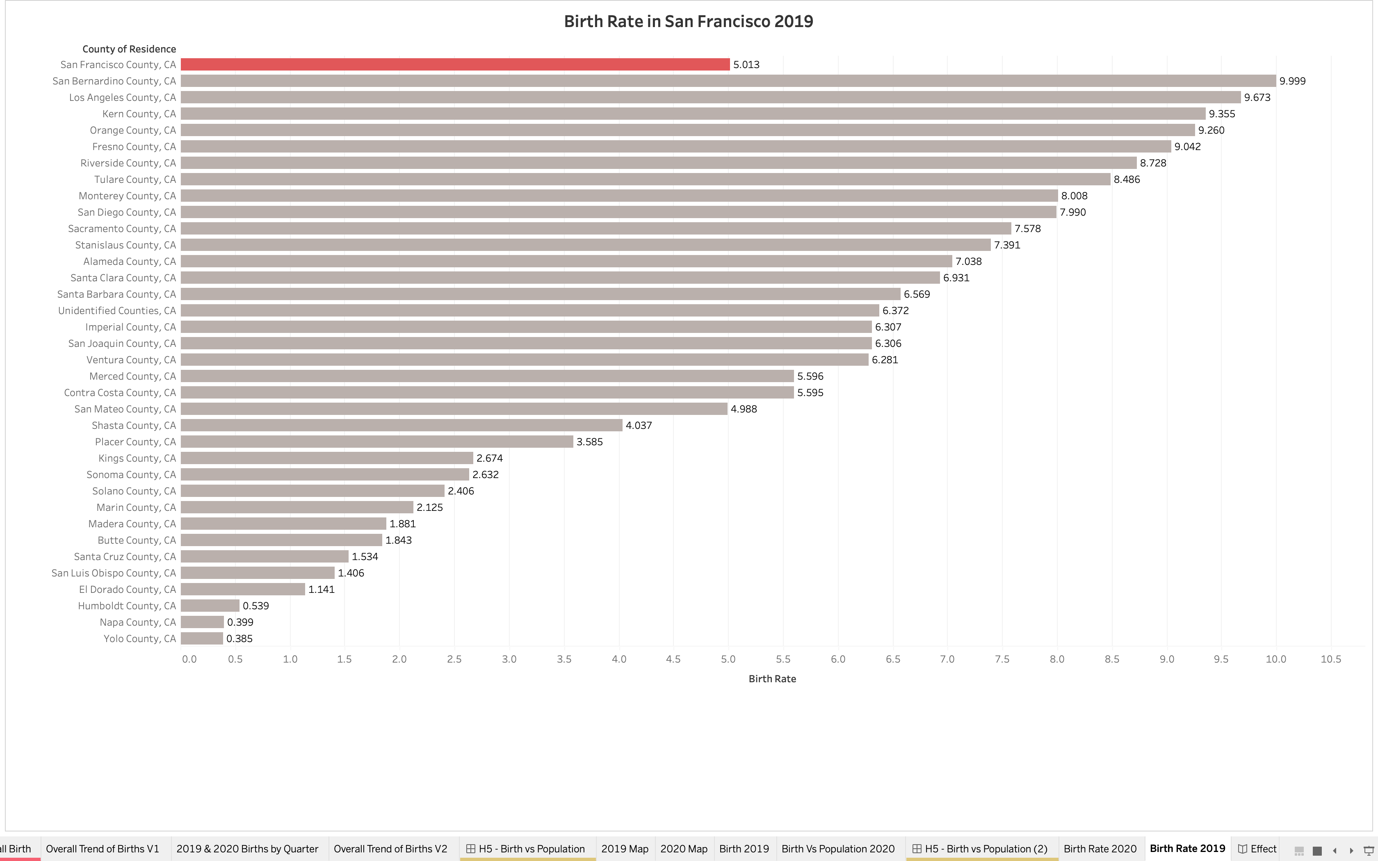

San Francisco doesn't have the highest birth rate compared to other counties even though it has the highest population density in California disapproving 5th hypothesis.
Birth Rate of San Francisco County in 2019: 5.013
Birth Rate of San Francisco County in 2020: 4.468
Thus, our hypothesis is proven to be false and rejected.

Slide 14
Conclusion
REJECTED - Hypothesis 1: Whether mothers in age group of 24-34 gave more births as compared to mothers of age group 35-44 in California Counties.
ACCEPTED - Hypothesis 2: Did mothers with higher degrees (bachelor’s degree and above) have less births than mothers with lower degrees (Associate degrees and lower) in California Counties.
REJECTED - Hypothesis 3: Whether the birth rate among white mothers decreased the most when compared with the other ethnicities in California during the pandemic.
ACCEPTED - Hypothesis 4: Whether the birth rate in California counties had an overall decrease in 2020 when compared to 2019 due to Covid.
REJECTED - Hypothesis 5: Whether San Francisco is more likely to have higher birth rate because of its higher population density.

Slide 15
Thank You!

